Slide 1

Problem Statement and Team Details
Problem Statement:
Team Name:
Team Leader Name:
Institute Name:
Theme Name:
Team Leader Email ID:
Design a computer vision object detection model that can help
automate tasks in space environments by enabling robots to visually
identify and locate essential tools during missions.
CODIES
Samarth Sharma
Inderprastha Engineering College
Duality AI
samarth120904@gmail.com

Slide 2
Problem and Solution
Problem Summary:
Solution Summary:
Develop a real-time object detection system for space station environments, precisely identifying critical safety tools: Fire Extinguisher, Toolbox, and Oxygen Tank. The core challenge was achieving high accuracy and real-time performance on low-resource devices for space robotics and astronaut support.
Our team utilized YOLOv8, training it on Duality AI's Falcon synthetic dataset to build a robust, real-time object detection model. The solution is optimized for low-resource environments and integrated into a mobile prototype.
Model: YOLOv8m (50 epochs, 640x640)
🔥 Fire Extinguisher
Performance (mAP@0.5): 94.2% overall
🫧 Oxygen Tank
Export: ONNX for cross-platform, low-latency inference
🧰 Toolbox
Integration: Flutter mobile app "ToolFinder AI"

Slide 3




Methodology & Implementation
Our project followed a rigorous pipeline to ensure an accurate and efficient YOLOv8-based object detection model for
critical space station tools.
Dataset Setup
Model Training (YOLOv8m)
Leveraged a 3.9GB Duality Falcon synthetic dataset, manually integrated for Fire Extinguisher, Toolbox, and Oxygen Tank classes.
Trained YOLOv8m for 50 epochs at 640x640 resolution using Ultralytics Python API for optimal performance and speed.
model = YOLO('yolov8m.pt')model.train(data='data.yaml', epochs=50, imgsz=640)
Model Validation
Real-time Prediction
Achieved high precision (0.898), recall (0.986), and mAP scores (94.2% @0.5, 88.4% @0.5:0.95), with detailed class-wise mAP.
Enabled robust predictions on test images, saving outputs with precise bounding boxes and labels for visualization.
model.predict(source='data/predict/images', save=True)

Slide 4
Technology Used
We integrated leading-edge machine learning, deployment, and app development tools to craft a comprehensive object
detection solution for space environments.
YOLOv8 (Ultralytics)
ONNX (Open Neural Network Exchange)
Chosen for real-time object detection, YOLOv8m delivers a crucial balance of speed and accuracy, achieving mAP@0.5 scores up to 94.2%.
Crucial for deployment, ONNX provides a lightweight, mobile-friendly, and cross-platform model format for optimized, low-latency inference.
Flutter
Hardware & Supporting Tools
Our mobile app, "ToolFinder AI," built with Flutter, showcases real-world applicability by integrating ONNX for on-device image input and predictions.
NVIDIA RTX 4050 for training, Python (Ultralytics), Dart (Flutter), Jupyter Notebooks, Duality AI's Falcon Simulator, and GitHub ensure reproducibility.

Slide 5
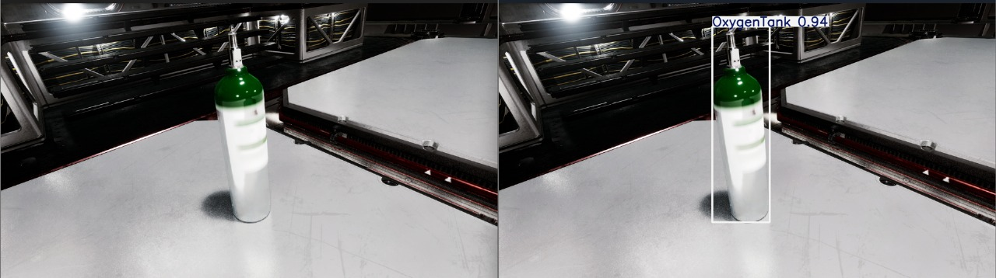
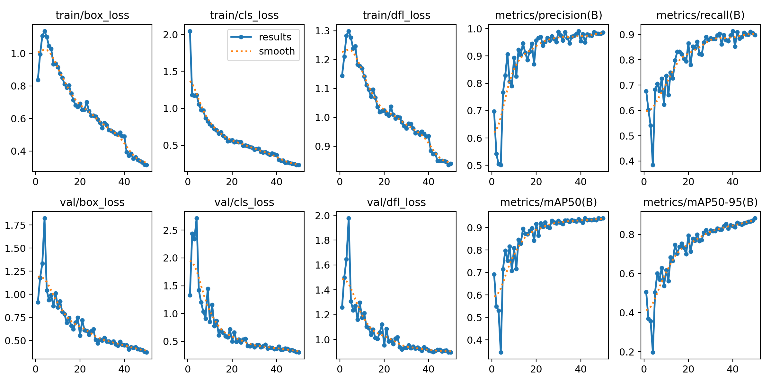

Supporting Images & Result
Supporting Image
Result

Slide 6
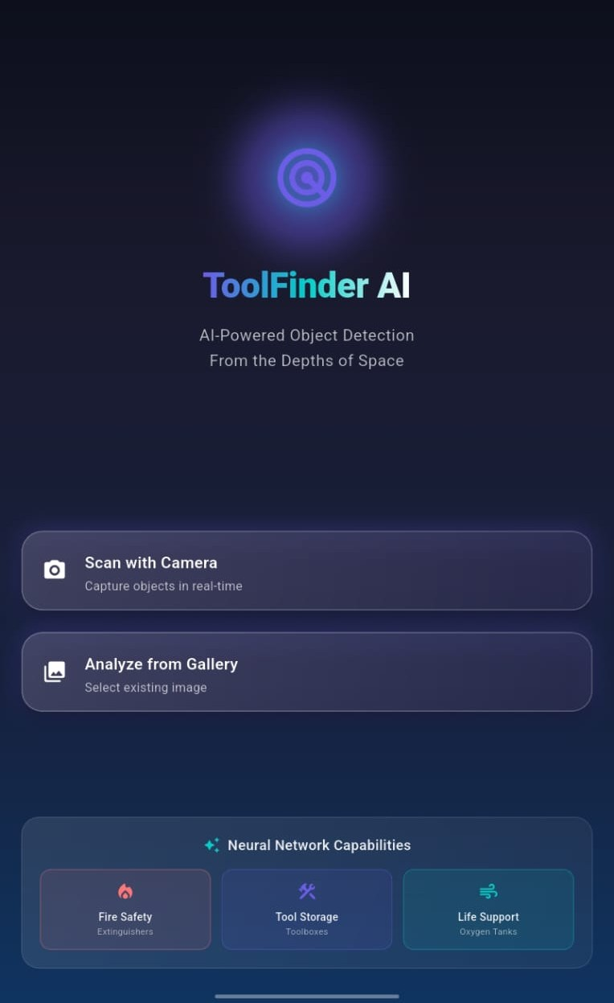
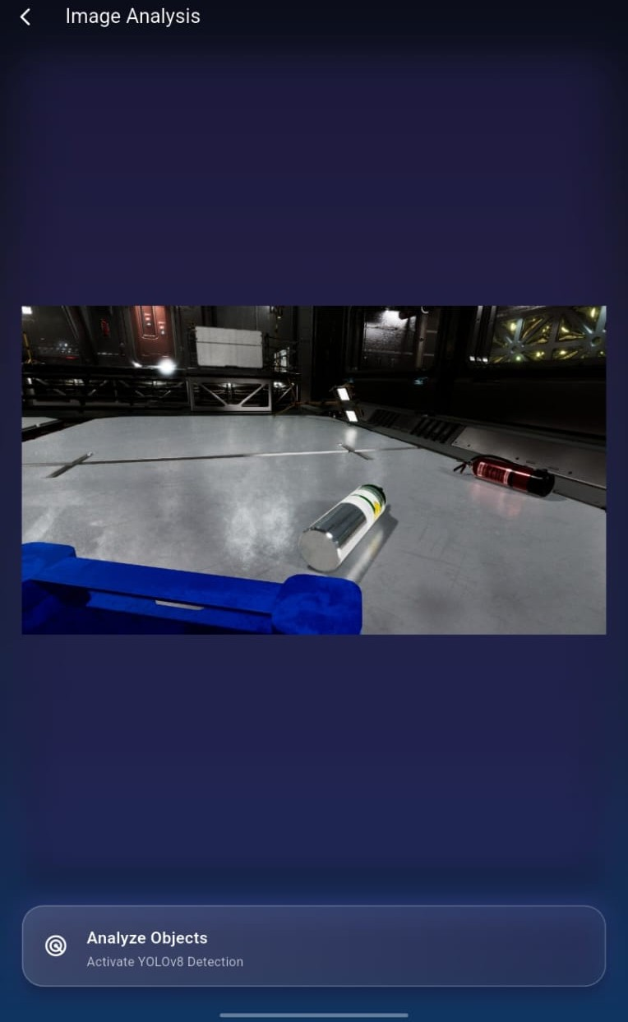
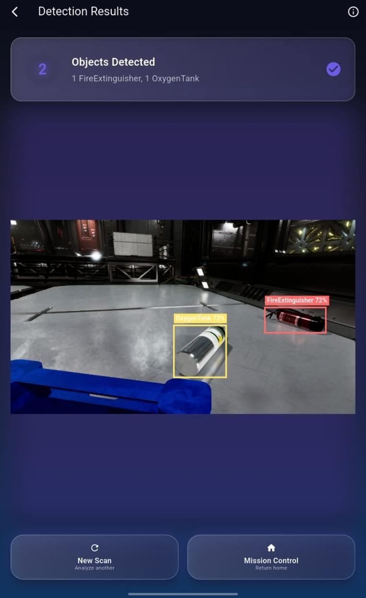
Project Demonstration
Home Screen
Preview Screen
Result Screen
The main interface, allowing users to initiate image capture or selection for object detection.
Displays the selected or captured image, ready for processing by the YOLOv8 model.
Visualizes the detection results, showcasing identified tools with bounding boxes and confidence scores.

Slide 7



Feasibility and Market Use
Feasibility
Market Use & Future Expansion
Our project demonstrates technical feasibility
through:
Our solution addresses critical needs in space
exploration and beyond:
Space Missions
High Accuracy: 94.2% mAP@0.5 ensures reliability in critical space environments.
ToolFinder AI aids astronauts/robots in quickly locating essential tools during missions or emergencies, enhancing safety and operational efficiency.
Real-Time Inference: ONNX export enables lightweight, offline deployment on mobile and edge devices.
Robotic Autonomy
Enables robotic arms to visually detect and manipulate tools autonomously, crucial for ISRO-style unmanned operations and maintenance.
Mobile Compatibility: The ToolFinder AI Flutter app validates real-world usability on Android/iOS.
Training Simulators
Hardware Efficiency: Optimized for low-resource environments, ideal for space stations.
Enhances astronaut training by providing a realistic visual tool identification system for simulated space environments.

Slide 8
Conclusion
Our real-time object detection system, developed using YOLOv8 on synthetic data, successfully identifies critical tools in simulated space environments with exceptional accuracy.
Key Outcomes:
Broader Impact & Future Prospects:
Achieved 94.2% mAP@0.5 accuracy for tool detection.
This project validates the feasibility of deploying AI vision systems in offline, resource-constrained environments like spacecraft, supporting astronaut safety, robot-assisted maintenance, and training simulations.
Optimized with YOLOv8m for speed and accuracy.
Scalable for more object categories.
Leveraged ONNX for cross-platform, mobile-ready
deployment.
Future optimization for edge devices (e.g., NVIDIA Jetson).
Developed ToolFinder AI, a functional Flutter app
for on-device inference.
Strong potential for real-world aerospace applications and ISRO's vision.
Our work bridges deep learning with critical real-world utility, creating a robust, mobile-ready AI vision system for high-stakes space missions.

